Slide 1
Instruction Pipelining
Pushpendra Kumar Pateriya

Slide 2
Performance
It is the time taken by the system to execute a program.
Performance affected by following parameters:
Clock speed
Type and number of instructions available
Average time required to execute an instruction
Memory access time
Power dissipation in the system
Number of I/O devices and types of I/O devices connected
The data transfer capacity of the bus

Slide 3

Important Fact
CPI: Cycles per instruction
IPC: Instructions per cycle
IPC = 1/CPI
CPU clock cycles = Number of instructions X Average clock cycles per instruction
CPU clock cycles $=\sum_{i=1}^{n}{NiXCPIi}$
CPU execution time = CPU clock cycles X Clock cycle time
CPU execution time = CPU clock cycles / Clock rate
CPU execution time = Instruction Count X CPI X Clock Cycle Time
CPU execution time = $\frac{Instructions}{Program}X\frac{Clock Cycle}{Instruction}X\frac{Seconds}{Clock Cycle}$
CPU execution time = Seconds / Program
Speedup = (Earlier execution time) / (Current execution time)

Slide 4
Instruction Processing
Single Cycle | Multiple Cycle | Pipeline
Cycle time long enough for the longest instruction | Cycle time long enough for the longest stage | Cycle time long enough for the longest stage
Entire cycle acts as a single stage | Shorter stages waste time | Shorter stages waste time
Shorter instruction waste time | Shorter instructions can take fewer cycles | No additional benefit from shorter instructions
No overlap | No overlap | Overlap instruction execution

Slide 5
5 Stage Instruction Cycle
Instruction Fetch
Decode (Interpret) Instruction
Fetch Operands
Perform Operation
Store Result

Slide 6
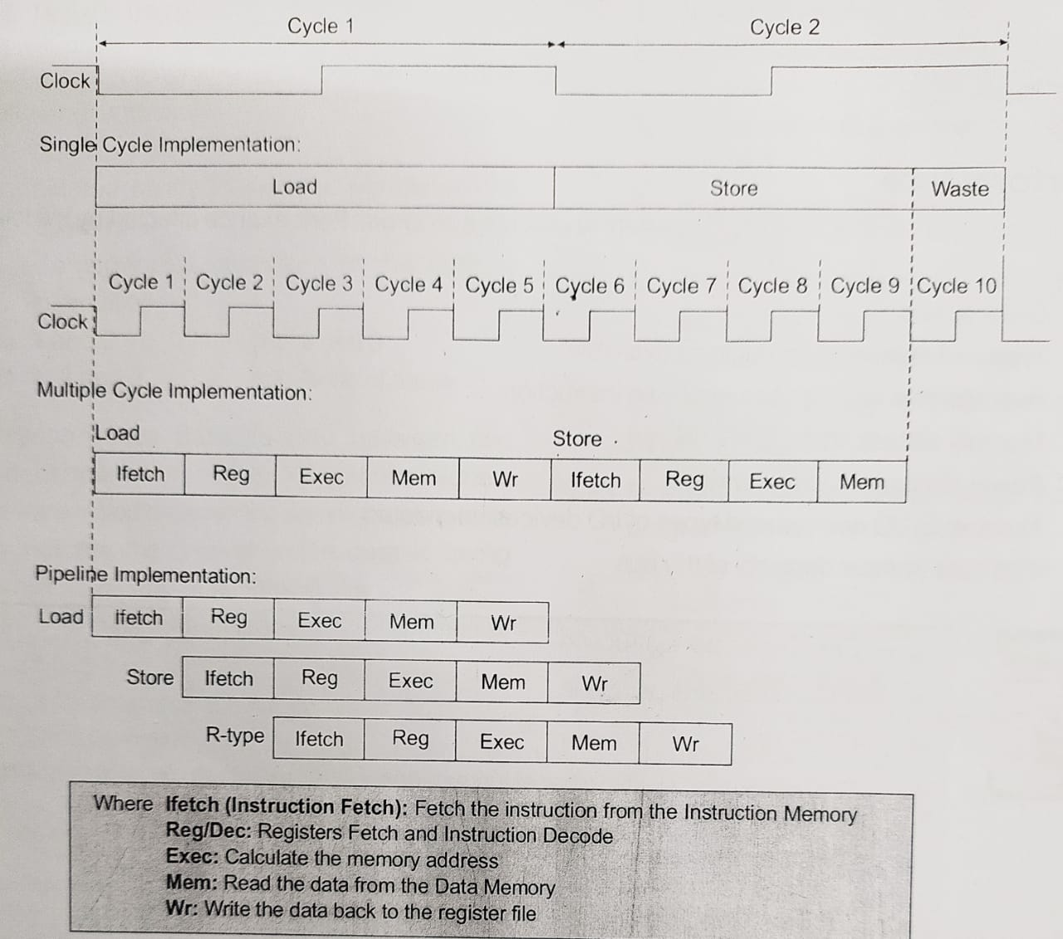

Slide 7
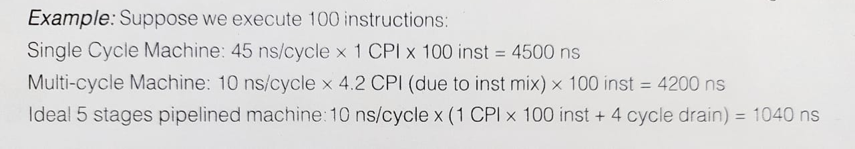

Slide 8
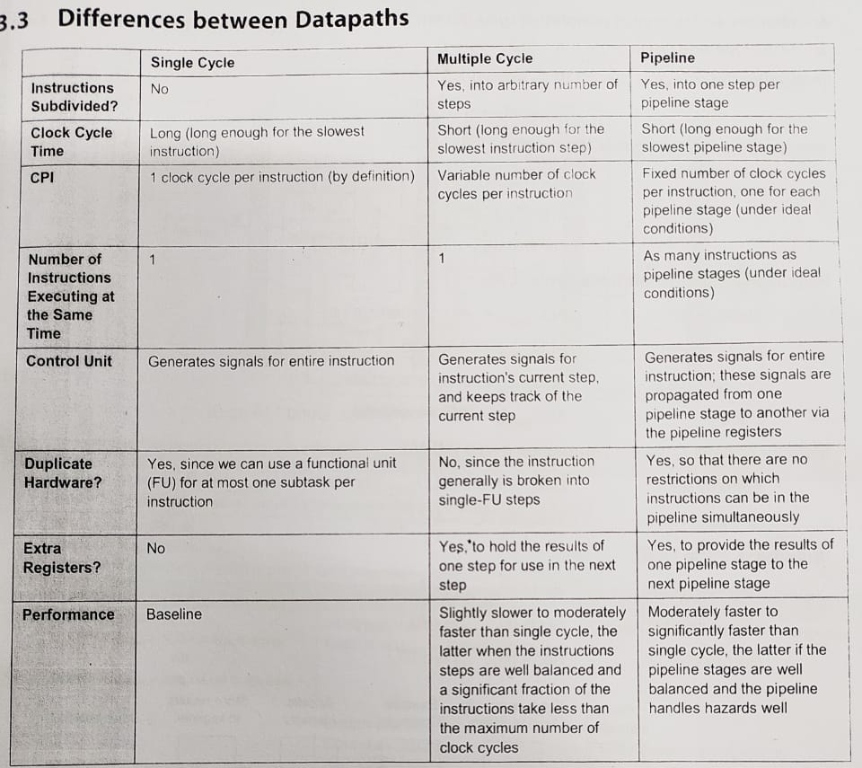

Slide 9
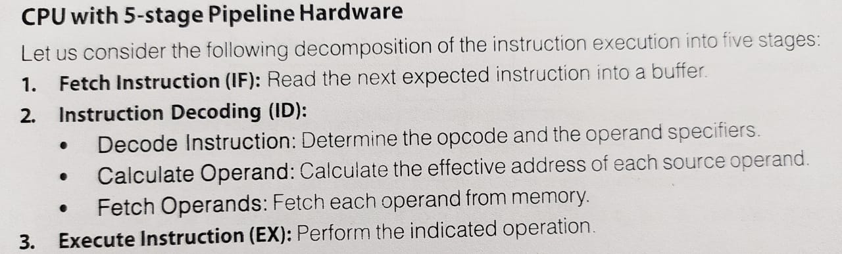
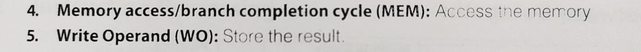
Pipeline Design and Issue

Slide 10
Problems in Instruction Pipelining
Timing Variations
Data Hazards
Branching
Interrupts

Slide 11
Pipeline Hazards
Structural Hazard
Different instructions trying to access the same piece of H/W in the same segment of pipeline.
Data Hazard
Instruction depends on the result of a prior instruction
RAW (True Data Dependency/Flow Dependency)
WAR (Antidependency)
WAW (Output Dependency)
Control Hazard

Slide 12
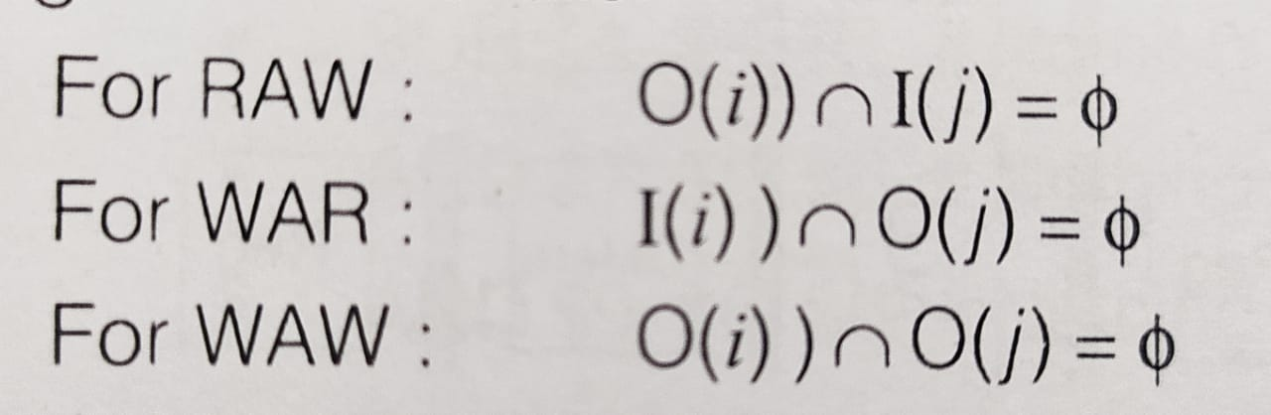
Berstein’s Conditions

Slide 13
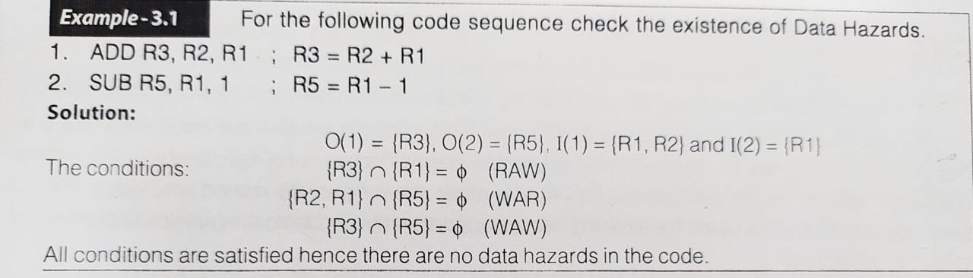

Slide 14
Handling Data Hazards
Forwarding: (Add special circuitry, which one forwards the desired value to the pipeline segment)
Code Re-Ordering
Stall Insertion: (n0-op instruction)

Slide 15
Control Hazard
Can result from branch instructions
Types of control hazards:
Jump to the branch target address if the instruction succeeds
Execute the instruction after the branch instruction if the branch fails

Slide 16
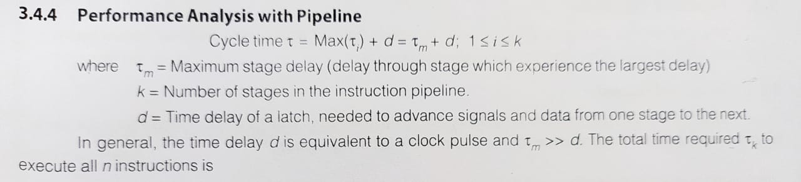

Slide 17
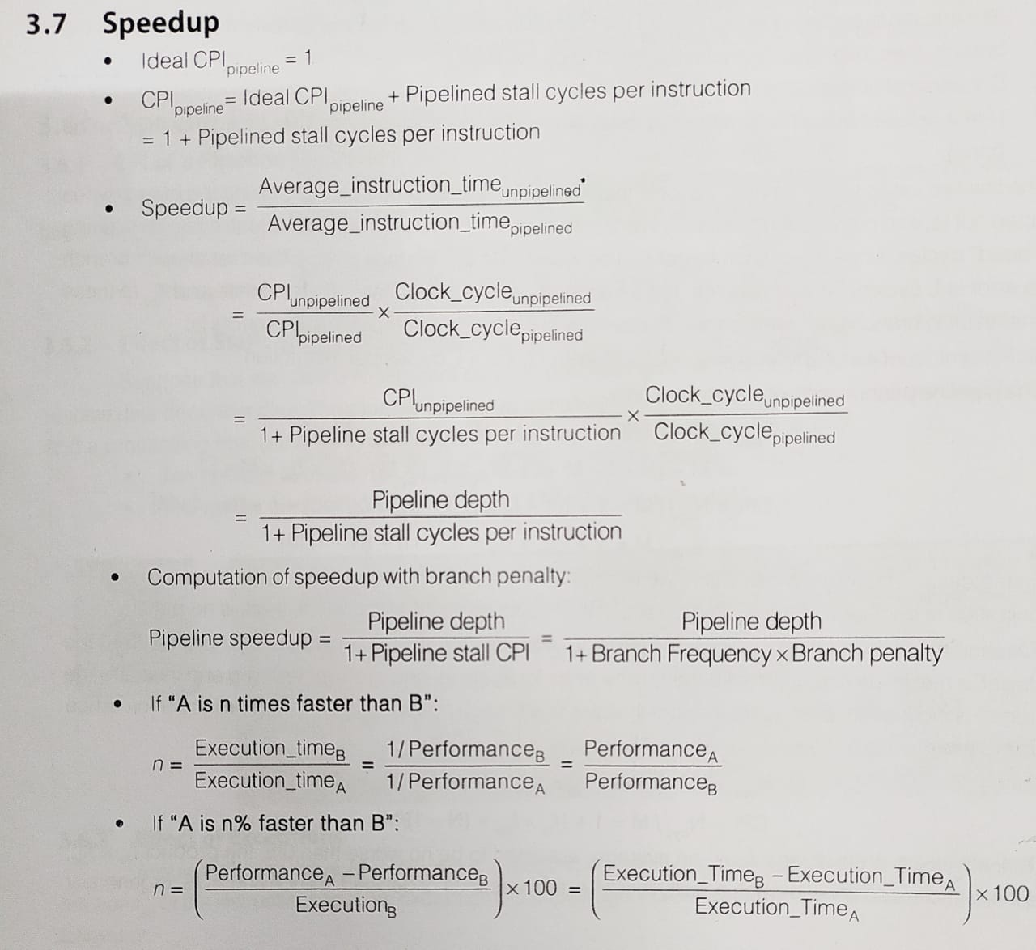

Slide 18
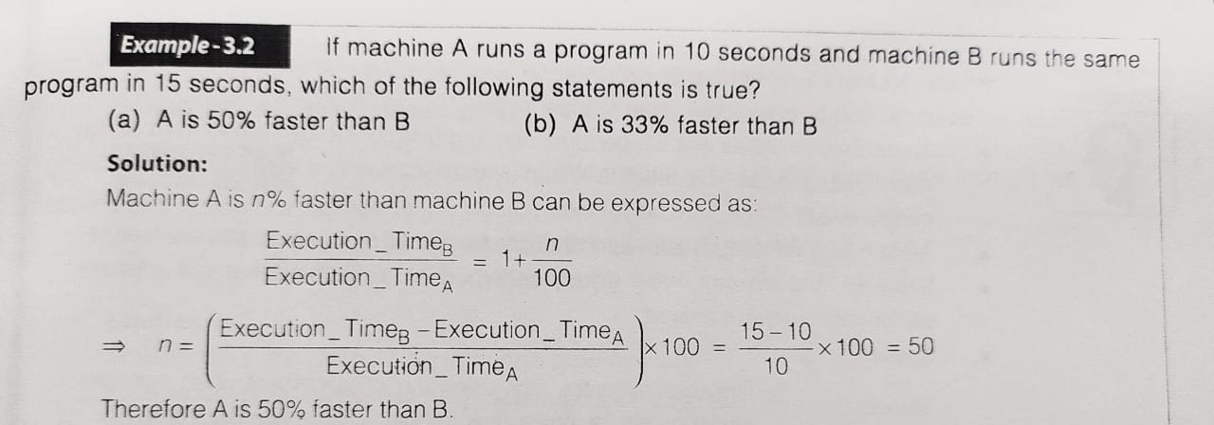

Slide 20
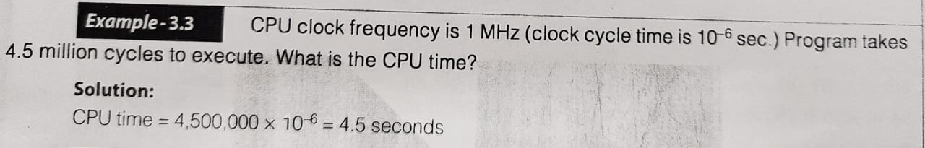

Slide 21
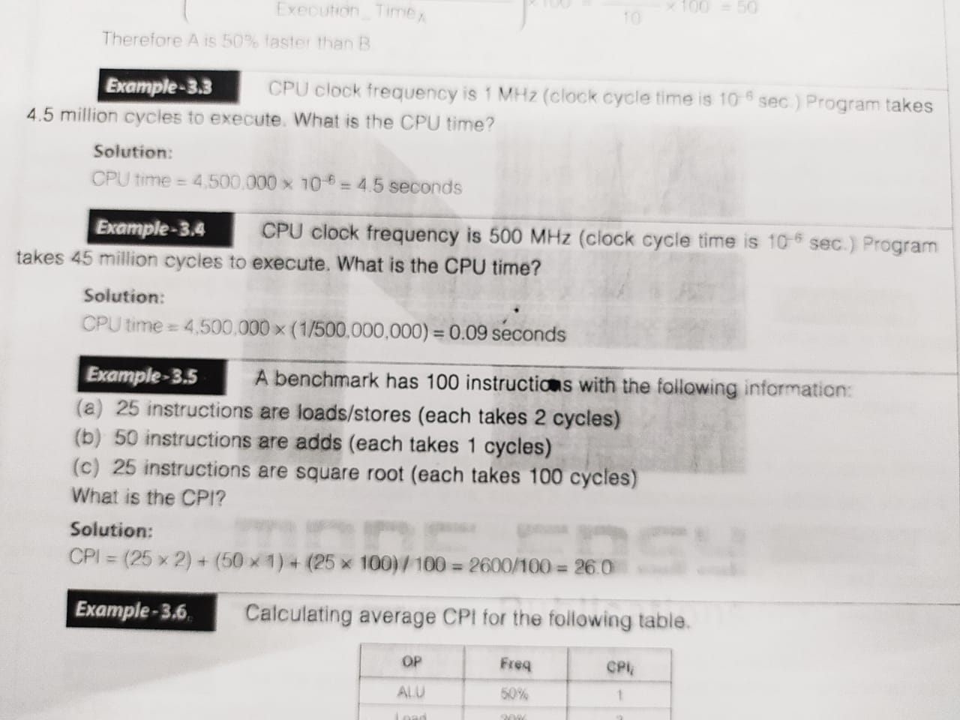

Slide 23
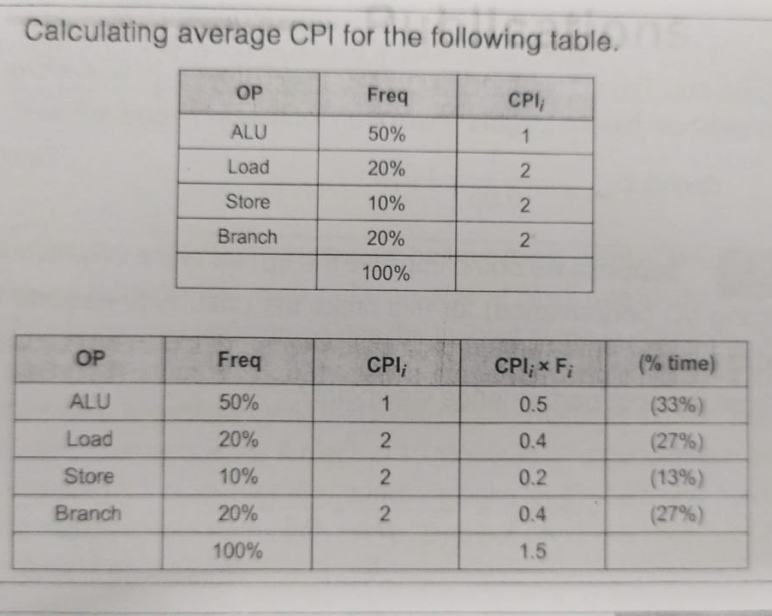

Slide 24
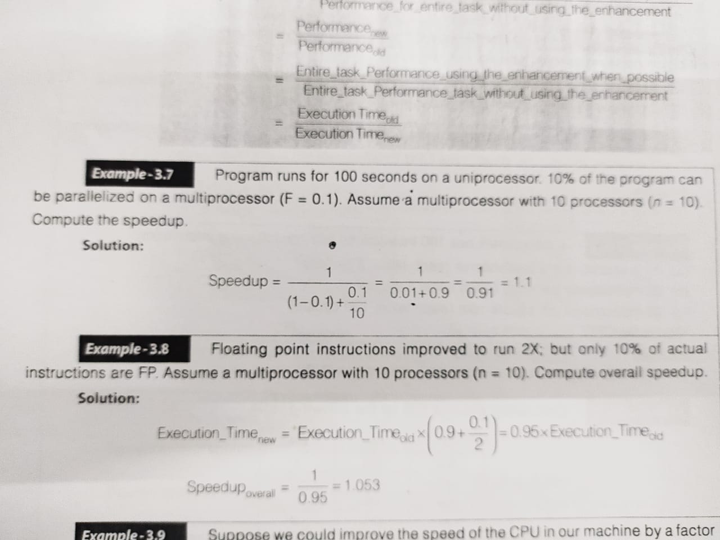

Slide 26
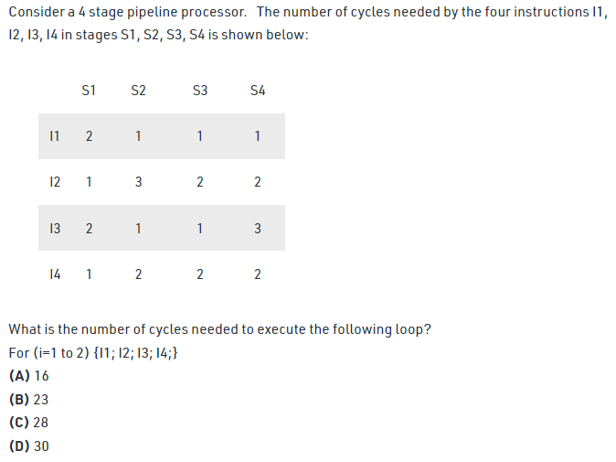

Slide 27
